Slide 1
MACHINE LEARNING
NOTES

Slide 2
SYLLABUS
INTRODUCTION:MACHINE LEARNING

Slide 3
Machine Learning (ML)
Machine Learning (ML) is a subfield of artificial intelligence (AI) that focuses on developing algorithms that enable computers to learn from data and make predictions or decisions without being explicitly programmed for each task. This technology allows machines to improve their performance over time by identifying patterns and relationships within datasets.

Slide 4
How Machine Learning Works
Machine learning algorithms operate by learning from data through a series of steps:
Data Collection: Relevant data is gathered, which could include images, text, numerical data, etc.
Data Preprocessing: The data is cleaned, transformed, and split into training and test sets.
Choosing a Model: A suitable machine learning model is selected based on the task, such as classification, regression, or clustering.
Training the Model: The model is trained using the training data, where it learns patterns and relationships.
Evaluating the Model: The model's performance is assessed using the test data with metrics like accuracy, precision, and recall.
Fine-tuning: Hyper parameters are adjusted to improve the model's performance.
Prediction or Inference: The trained model is used to make predictions on new data.

Slide 5
Types of Machine Learning
Machine learning can be categorized into three main types:
Supervised Learning: The algorithm is trained on labeled data, learning to map input features to output labels. Examples include regression and classification tasks
Unsupervised Learning: The algorithm learns patterns from unlabeled data, identifying structures like clusters or reducing dimensionality
Reinforcement Learning: The algorithm learns by interacting with an environment, receiving rewards or penalties based on its actions to optimize a policy

Slide 6
Applications of Machine Learning
Machine learning has a wide range of applications across various industries:
Recommendation Systems: Suggesting products, movies, or music based on user preferences
Fraud Detection: Identifying suspicious transactions in financial systems
Autonomous Vehicles: Enhancing the adaptability and safety of self-driving cars
Healthcare: Improving diagnostics and treatment plans through image recognition and predictive modeling
Natural Language Processing: Enabling voice recognition, chatbots, and language translation

Slide 7
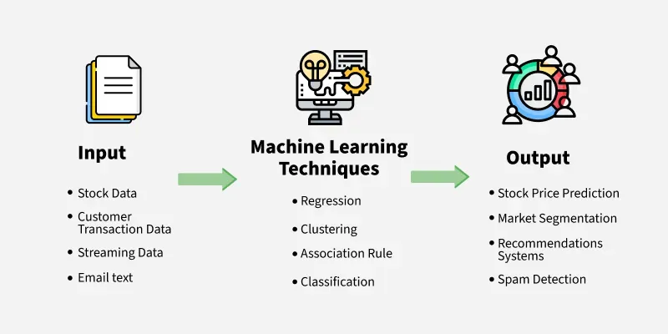
Benefits and Challenges

Slide 8
ML
Machine learning is important because it allows computers to learn from data and improve their performance on specific tasks without being explicitly programmed. This ability to learn from data and adapt to new situations makes machine learning particularly useful for tasks that involve large amounts of data, complex decision-making, and dynamic environments.
Here are some specific areas where machine learning is being used:
Predictive modeling: Machine learning can be used to build predictive models that can help businesses make better decisions. For example, machine learning can be used to predict which customers are most likely to buy a particular product, or which patients are most likely to develop a certain disease.
Natural language processing: Machine learning is used to build systems that can understand and interpret human language. This is important for applications such as voice recognition, chatbots, and language translation.
Computer vision: Machine learning is used to build systems that can recognize and interpret images and videos. This is important for applications such as self-driving cars, surveillance systems, and medical imaging.
Fraud detection: Machine learning can be used to detect fraudulent behavior in financial transactions, online advertising, and other areas.

Slide 9
Difference between Machine Learning, Traditional Programming and Artificial Intelligence
Machine Learning | Traditional Programming | Artificial Intelligence
A subset of AI focusing on creating algorithms that learn from data and make predictions. | Writing rule-based, deterministic code based on specific problem statements. | Technology that enables machines to perform tasks that typically require human intelligence.
Data-driven, learns from historical data to predict future outcomes. | Rule-based and deterministic, relies on explicit instructions from developers. | Uses a mix of data-driven techniques and predefined rules, incorporating ML, deep learning, and traditional programming.
Capable of finding patterns and insights in large datasets, learning and improving over time. | Lacks self-learning capabilities; output is directly tied to input and predefined rules. | Adapts and evolves to perform complex tasks with high accuracy, often exceeding human capabilities in specific domains.
Used in predictive analytics, autonomous vehicles, chatbots, and other AI-based applications. | Used to build applications with specific functionalities like software tools and systems. | Broad applications including natural language processing, computer vision, robotics, and more.
Dependent on the quality and diversity of data. Can perform poorly if data is not representative. | Dependent on the intelligence and foresight of developers. Limited to known scenarios. | Combines the strengths of both ML and traditional programming to tackle complex, multi-faceted problems.

Slide 10
How machine learning algorithms work?
A machine learning algorithm works by learning patterns and relationships from data to make predictions or decisions without being explicitly programmed for each task.
Here's a simplified overview of how a typical machine learning algorithm works:
1. Data Collection
First, relevant data is collected or curated. This data could include examples, features, or attributes that are important for the task at hand, such as images, text, numerical data, etc.
2. Data Preprocessing
Before feeding the data into the algorithm, it often needs to be preprocessed. This step may involve cleaning the data (handling missing values, outliers), transforming the data (normalization, scaling), and splitting it into training and test sets.
3. Choosing a Model
Depending on the task (e.g., classification, regression, clustering), a suitable machine learning model is chosen. Examples include decision trees, neural networks, support vector machines, and more advanced models like deep learning architectures.
4. Training the Model
The selected model is trained using the training data. During training, the algorithm learns patterns and relationships in the data. This involves adjusting model parameters iteratively to minimize the difference between predicted outputs and actual outputs (labels or targets) in the training data.
5. Evaluating the Model
Once trained, the model is evaluated using the test data to assess its performance. Metrics such as accuracy, precision, recall, or mean squared error are used to evaluate how well the model generalizes to new, unseen data.
6. Fine-tuning
Models may be fine-tuned by adjusting hyperparameters (parameters that are not directly learned during training, like learning rate or number of hidden layers in a neural network) to improve performance.
7. Prediction or Inference
Finally, the trained model is used to make predictions or decisions on new data. This process involves applying the learned patterns to new inputs to generate outputs, such as class labels in classification tasks or numerical values in regression tasks.

Slide 11
Machine Learning Lifecycle
The machine learning lifecycle includes:
Defining the Problem: Clearly identify the real-world problem to be solved.
Data Collection: Gather necessary data from various sources.
Data Cleaning and Preprocessing: Resolve data quality issues and prepare the data for analysis.
Exploratory Data Analysis (EDA): Analyze data to identify patterns, outliers, and trends.
Feature Engineering and Selection: Enhance data features and select relevant ones to improve model performance.
Model Selection: Choose suitable models based on the problem type and data characteristics.
Model Training: Train the model using a split of training and validation datasets.
Model Evaluation and Tuning: Assess and optimize the model using relevant metrics.
Model Deployment: Implement the model in a production environment for real-time predictions.
Model Monitoring and Maintenance: Regularly check and update the model to maintain accuracy.

Slide 12
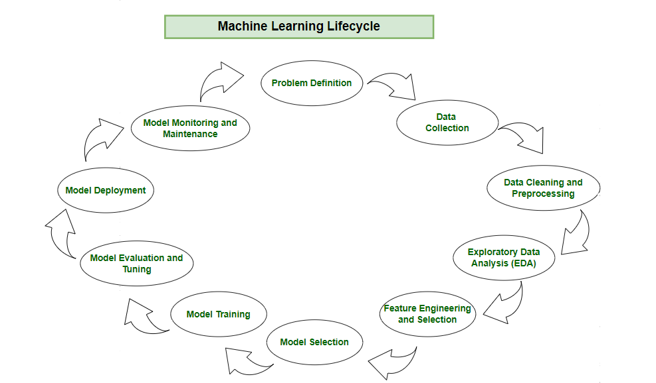
ML

Slide 13
Types of Machine Learning
Types of Machine Learning
1. Supervised Machine Learning
Supervised learning algorithms are trained on the labeled dataset. They learn to map input features to targets based on labeled training data. There are two main types of supervised learning:
Regression: Regression algorithm learns to predict continuous values based on input features.
Classification: Classification algorithm learns to assign input data to a specific category or class based on input features. The output labels in classification are discrete values.

Slide 14
2. Unsupervised Machine Learning
Unsupervised learning algorithm learns to recognize patterns in data without being explicitly trained using labeled examples. The goal is to discover the underlying structure or distribution in the data.
There are two main types of unsupervised learning:
Clustering: Clustering algorithms group similar data points together based on their characteristics. The goal is to identify groups, or clusters, of data points that are similar to each other, while being distinct from other groups.
Dimensionality reduction: Dimensionality reduction algorithms reduce the number of input variables in a dataset while preserving as much of the original information as possible. This is useful for reducing the complexity of a dataset and making it easier to visualize and analyze.

Slide 15
3. Reinforcement Machine Learning
In Reinforcement Learning, an agent learns to interact with an environment by performing actions and receiving rewards or penalties based on its actions. The goal of reinforcement learning is to learn a policy, which is a mapping from states to actions, that maximizes the expected cumulative reward over time.
There are two main types of reinforcement learning:
Model-based reinforcement learning: The agent learns a model of the environment, including the transition probabilities between states and the rewards associated with each state-action pair. The agent then uses this model to plan its actions in order to maximize its expected reward.
Model-free reinforcement learning: The agent learns a policy directly from experience without explicitly building a model of the environment. The agent interacts with the environment and updates its policy based on the rewards it receives.

Slide 16
Various Applications of Machine Learning
Automation: Machine learning, which works entirely autonomously in any field without the need for any human intervention. For example, robots perform the essential process steps in manufacturing plants.
Finance Industry: Machine learning is growing in popularity in the finance industry. Banks are mainly using ML to find patterns inside the data but also to prevent fraud.
Government organization: The government makes use of ML to manage public safety and utilities. Take the example of China with its massive face recognition. The government uses Artificial intelligence to prevent jaywalking.
Healthcare industry: Healthcare was one of the first industries to use machine learning with image detection.
Marketing: Broad use of AI is done in marketing thanks to abundant access to data. Before the age of mass data, researchers develop advanced mathematical tools like Bayesian analysis to estimate the value of a customer. With the boom of data, the marketing department relies on AI to optimize customer relationships and marketing campaigns.
Retail industry: Machine learning is used in the retail industry to analyze customer behavior, predict demand, and manage inventory. It also helps retailers to personalize the shopping experience for each customer by recommending products based on their past purchases and preferences.
Transportation: Machine learning is used in the transportation industry to optimize routes, reduce fuel consumption, and improve the overall efficiency of transportation systems. It also plays a role in autonomous vehicles, where ML algorithms are used to make decisions about navigation and safety.

Slide 17
Limitations of Machine Learning
Data Availability: Machines require sufficient data to learn; without it, learning cannot occur.
Diversity in Data: A lack of diversity within the dataset can significantly hinder machine learning processes.
Need for Heterogeneity: Diverse and varied data are crucial for extracting meaningful insights.
Impact of Low Variation: Algorithms struggle to derive information from datasets with minimal variation.
Observations Per Group: It is recommended to have at least 20 observations per group to ensure effective learning.

Slide 18
Explanation of the PAC Learning Framework and Its Importance
What is PAC Learning?
Probably Approximately Correct (PAC) learning is a theoretical framework introduced by Leslie Valiant in 1984. It addresses the problem of learning a function from a set of samples in a way that is both probably correct and approximately correct. In simpler terms, PAC learning formalizes the conditions under which a learning algorithm can be expected to perform well on new, unseen data after being trained on a finite set of examples.

Slide 19
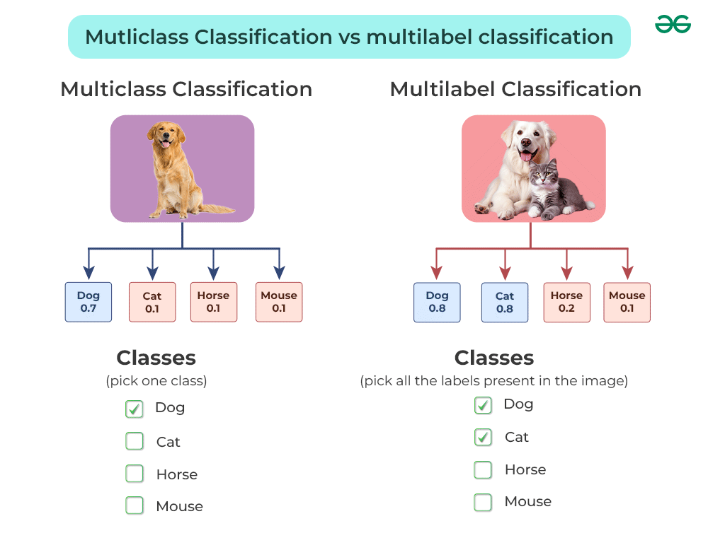
Multiclassification

Slide 20
Multiclass classification
Multiclass classification is a machine learning challenge focused on categorizing data into more than two classes. While binary classification involves distinguishing between only two classes, multiclass classification expands this scope to involve distinguishing between multiple classes.
Multiclass classification is a type of machine learning task where the goal is to categorize instances into one of several predefined classes. Unlike binary classification, where there are only two possible outcomes, multiclass classification involves distinguishing between multiple classes or categories.
Multiclass classification finds application in a wide range of real-world scenarios.

Slide 21
F1 Score in Machine Learning
F1 Score is a performance metric used in machine learning to evaluate how well a classification model performs on a dataset especially when the classes are imbalanced meaning one class appears much more frequently than another. It is the harmonic mean of precision and recall which combine both metrics into a single value that balances their importance.
Before understanding F1 Score let's understand two key terms:

Slide 22
1. Precision:
It refers to the proportion of correct positive predictions (True Positives) out of all the positive predictions made by the model (True Positives + False Positives). It is a measure of the accuracy of the positive predictions. The formula for Precision is:
Precision=True Positives/False Positives+True Positives​
For example, if there are 10 positive cases and 5 negative cases. The model can identify 5 positive cases. But out of these 5 identified cases only 4 are positive and 1 is negative. Thus precision becomes 80% (4/5).

Slide 23
2. Recall:
It is also known as Sensitivity or True Positive Rate where we measures the proportion of actual positive instances that were correctly identified by the model. It is the ratio of True Positives to the total actual positives (True Positives + False Negatives). The formula for Recall is:
Recall=True Positives+False NegativesTrue Positives​
the previous example. Although the model's precision is quite high at 80% the recall will be significantly lower. Given 10 actual positive cases the model only identified 4 positive cases correctly. Therefore the recall can be calculated as 40% (4/10).

Slide 24
To better understand Precision and Recall we can use a Confusion Matrix which summarizes the performance of a classifier in four essential terms:
True Positives (TP): Correctly predicted positive instances.
False Positives (FP): Incorrectly predicted positive instances.
True Negatives (TN): Correctly predicted negative instances.
False Negatives (FN): Incorrectly predicted negative instances.

Slide 25
F1 Score by combining Precision and Recall
F1 Score combines precision and recall using the harmonic mean:
F1 Score=2×Precision×RecallPrecision+RecallF1​ Score=2×Precision+RecallPrecision×Recall​
This formula ensures that both precision and recall must be high for the F1 score to be high. If either one drops significantly the F1 score will also drop.

Slide 26
1. Binary Classification
In binary classification where there are only two classes (positive and negative) the F1 score can be computed from the confusion matrix that helps calculate metrics such as precision, recall and the F1 score.
Let's take an example of a dataset with 100 total cases. Out of these 90 are positive and 10 are negative cases. The model predicted 85 positive cases out of which 80 are actual positive and 5 are from actual negative cases. The confusion matrix would look like:

Slide 27
Example
Example | Actual |  | Total
Model Prediction | 80 | 5 | 85 | Precision = (80/85) = 0.94
 | 10 | 5 | 15
Total | 90 | 10 | 100
 | Recall = (80/90) = 0.88 |  | Accuracy = (80+5)/100 = 85% | F1 = 0.91

Slide 28
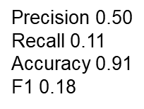
Example 1: Consider the below case where there are only 9 cases of true positives out of a dataset of 100.
Actual |  | Total
Model Prediction | 1 | 1 | 2
 | 8 | 90 | 98
Total | 9 | 91 | 100

Slide 29
case if we give importance to accuracy over model will predict everything as negative. This gives us an accuracy of 91 %. However our F1 score is low.

Slide 30
F1 score
In a multi-class classification problem where there are more than two classes we calculate the F1 score per class rather than providing a single overall F1 score for the entire model. This approach is often referred to as the one-vs-rest (OvR) or one-vs-all (OvA) strategy.
For each class in the multi-class problem a binary classification problem is created.
We treat one class as the positive class and the rest of the classes as the negative class.
Then we proceed to calculate the F1 score as outlined above.
For a specific class the true positives (TP) are the instances correctly classified as that class, false positives (FP) are instances incorrectly classified as that class and false negatives (FN) are instances of that class incorrectly classified as other classes.

Slide 31
Implementing F1 Score in Python
calculate the F1 score in Python using the f1_score function from the sklearn.metrics module. This function supports both binary and multi-class classification.
Here's an explanation of the function and its parameters:
f1_score function takes two required parameters: y_true and y_pred along with an optional parameter average.
y_true: This parameter represents the true labels for the instances, providing the actual outcomes that the model is trying to predict.
y_pred: This parameter contains the predicted labels from the model indicating the model's output based on the input data.
average: This parameter defines the type of averaging performed on the data. It is a optional parameter.

Slide 32
from sklearn.metrics
from sklearn.metrics import f1_score
y_true = [0, 1, 2, 2, 2, 2, 1, 0, 2, 1, 0]
y_pred = [0, 0, 2, 2, 1, 2, 1, 0, 1, 2, 1]
f1_per_class = f1_score(y_true, y_pred, average=None)
f1_micro = f1_score(y_true, y_pred, average='micro')
f1_macro = f1_score(y_true, y_pred, average='macro')
f1_weighted = f1_score(y_true, y_pred, average='weighted')
print("F1 score per class:", f1_per_class)
print("Micro-average F1 score:", f1_micro)
print("Macro-average F1 score:", f1_macro)
print("Weighted-average F1 score:", f1_weighted)

Slide 33
Implementing F1 Score in Python
Micro-average: Calculates metrics globally by counting the total true positives, false negatives and false positives.
Macro-average: Averages the F1 score for each class without considering class imbalance.
Weighted-average: Considers class imbalance by weighting the F1 scores by the number of true instances for each class.

